Slide 1
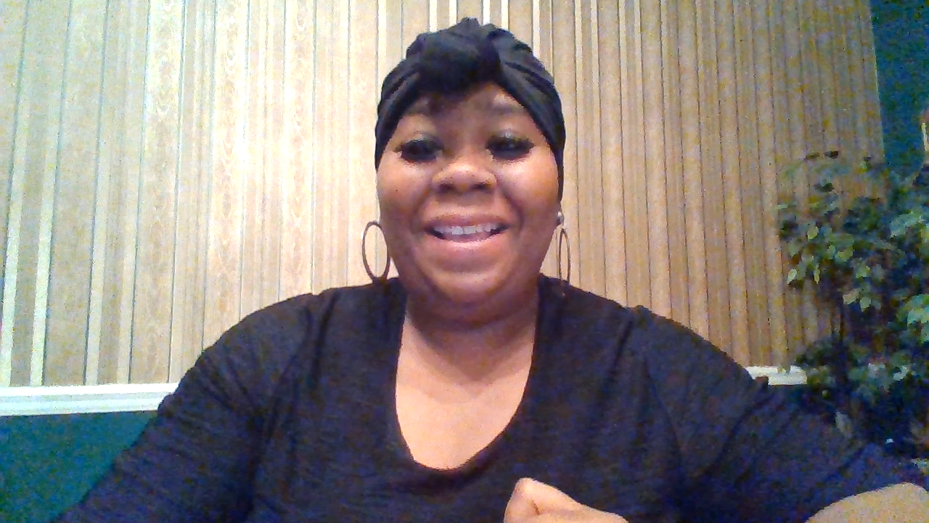
Toria Randle
2nd Grade Math Teacher

Slide 2
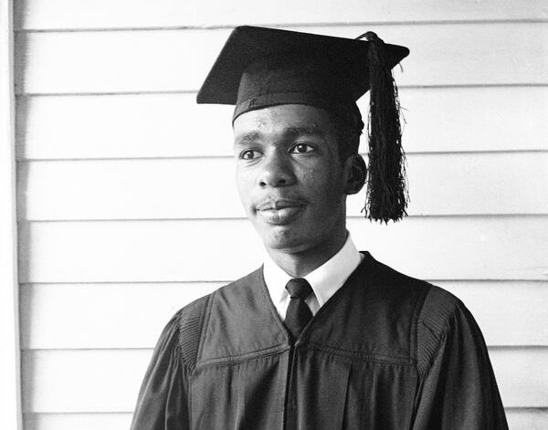

Black History Month
Ernest Gideon Green

Slide 3
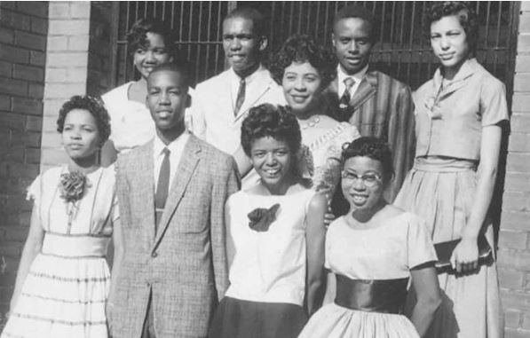
ERNEST GREEN and THE LITTLE ROCK NINE

Slide 4
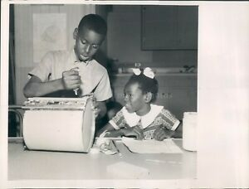
ERNEST GREEN and THE LITTLE ROCK NINE
Ernest G. Green was an African-American who was part of the civil rights movement.
He was born in Little Rock, Arkansas on September 22, 1941. He was born to Lothaire
S. and Ernest Green Sr. His parents filled him with confidence and self-respect. Ernest
Green had two siblings: One brother, Scott, and one sister, Treopia Washington.

Slide 5
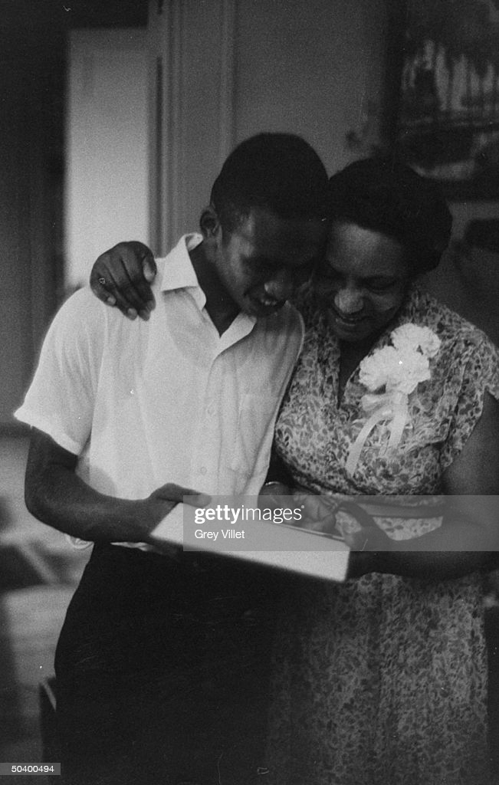
ERNEST GREEN and THE LITTLE ROCK NINE
As a child Ernest Green was an active member of the community, he regularly attended church. He used to be a boy scout. Later, he became an Eagle scout.
While growing up, Ernest, like every other kid back then, had a normal life and a very happy one, too.

Slide 6
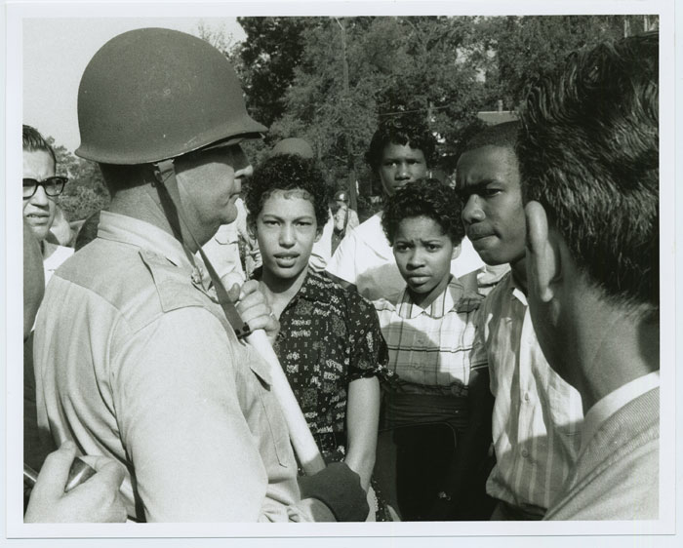
ERNEST GREEN and THE LITTLE ROCK NINE
Ernest first started by going to Central High School, then he later signed up to attend to Little Rock High School. He was one of the members of “ Little Rock Nine”. He attended Little Rock High School on the morning of September 25, 1957. Governor Orval Faubus had summoned some paratroopers to escort Ernest Green and the rest of the Little Rock nine to their classes, but the troops couldn't go into the classes with them, and they just waited outside the class. The white students didn't want Ernest Green or any of them around so every chance they got they would bully Ernest and do whatever they could to get them out of the school.

Slide 7
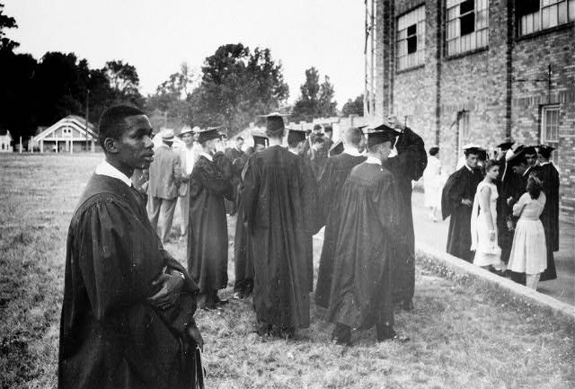
ERNEST GREEN and THE LITTLE ROCK NINE
Out of all nine of the little rock nine only one graduated at that school. That one was the
one who was confident and had self-respect, it was Ernest green. He graduated from Little
Rock High School on May of 1958. He then graduated from Michigan State University with
a B.A. in 1969 and a M.A. in 1964.

Slide 8

ERNEST GREEN and THE LITTLE ROCK NINE
Since Ernest's story is very inspiring, they decided to make a movie about it. It's called "The Ernest Green Story". It's about the true story of Ernest Green and the little rock nine. The film was developed, and executively produced by Carol Ann Abrams. Much of the movie was filmed on location at Central High School. It aired on Disney Channel on January 17,1993.

Slide 9
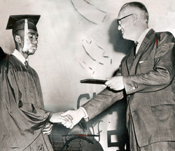
ERNEST GREEN and THE LITTLE ROCK NINE
It's just the price we've got to pay. And for what is involved, I think it is cheap at the price.

